Slide 1


Jakub Sisma
2024/04/03

Slide 2

Outline
Executive Summary
Introduction
Methodology
Results
Conclusion
Appendix

Slide 3
Executive Summary
This project uses data science methods to get insights into rocket launch costs and the success of landing stage 1.
Based on created models using data science we can predict the success of landing the first stage in 83.3% of the time.

Slide 4
Introduction
In this project we are going to take the role of a data scientists working for a new rocket company. Our job is to determine the price of each launch by gathering information about Space X and creating dashboards for our team. We will also determine if SpaceX will reuse the first stage.
We will attempt to answer the following problems: where are the launches executed and on what scale? What is the rate of successful launches? Can we predict if the landing of stage 1 will be successful?

Slide 5

Section 1

Slide 6
Methodology
Executive Summary
Data collection methodology:
APIs, Webscraping
Perform data wrangling
Dropp null values, create ‘Class‘ variable
Perform exploratory data analysis (EDA) using visualization and SQL
Perform interactive visual analytics using Folium and Plotly Dash
Perform predictive analysis using classification models
SVM, Logistic Regression, Decision Tree,

Slide 7
Data Collection – SpaceX API
Find API
Find the API address
Get data
Use get function to get the data
Transform
Transform the data file into a pandas dataframe
https://github.com/DonKubini/ibm-capstone/blob/main/Module%201/jupyter-labs-spacex-data-collection-api-v2.ipynb

Slide 8
Data Collection - Scraping
Find Wikipedia artice
Find the Wikipedia article url
Get data
Use get function to get the data
Transform
Use beautiful soup library to extract the data into a dataframe
https://github.com/DonKubini/ibm-capstone/blob/main/Module%201/jupyter-labs-webscraping.ipynb

Slide 9
Data Wrangling
Important to create necessary features and deal with null values
Understand your data
Use pandas functions to get basic understanding of the data structure
Deal with NA values
Drop unnecessary null values or transform them into averages
Create class column
Create a new column that contains the info on success of launch
https://github.com/DonKubini/ibm-capstone/blob/main/Module%201/labs-jupyter-spacex-Data%20wrangling-v2.ipynb

Slide 10
EDA with Data Visualization
We used multiple scatterplots to understand relationships between different variables
We used a bar plot to visualize the success rate of launch per orbit
We used a line chart to visualize the succes rate trend over time
https://github.com/DonKubini/ibm-capstone/blob/main/Module%202/jupyter-labs-eda-dataviz-v2.ipynb

Slide 11
EDA with SQL
We used SQL queries to display the following:
Unique launch sites in the space mission
Total payload mass of NASA (CRS) boosters
Booster versions that were successful with specific payload mass range
Total number of successful and unsuccessful mission outcomes
Boosters that carried the maximu payload mass
And more…
https://github.com/DonKubini/ibm-capstone/blob/main/Module%202/jupyter-labs-eda-sql-coursera_sqllite.ipynb

Slide 12
Build an Interactive Map with Folium
We used interactive circles, markers and lines to identify launch sites and their respective successful and unsuccessful attempts
Add the GitHub URL of your completed interactive map with Folium map, as an external reference and peer-review purpose
https://github.com/DonKubini/ibm-capstone/blob/main/Module%203/lab-jupyter-launch-site-location-v2.ipynb

Slide 13
Build a Dashboard with Plotly Dash
We used a drop down menu so the user can choose a location. The location will display a success rate pie chart
We used a slider to select payload range. This will display the relationship between payload and success based on selected location
https://github.com/DonKubini/ibm-capstone/blob/main/Module%203/spacex-dash-app.py

Slide 14
Predictive Analysis (Classification)
Standardize and spilt the data
Use StandardScaler to standardize the predictors
CV and Grid Search
Use grid search cross-validation to find the best parameters on the training data (for each model)
Test and evaluate the models
Get predictions, accuracy score and confusion matrix for each model
Split the data into training and testing splits
Evaluate different models
https://github.com/DonKubini/ibm-capstone/blob/main/Module%204/SpaceX-Machine-Learning-Prediction-Part-5-v1.ipynb

Slide 15
Results
Models ranked on accuracy:
Logistic Regression: 83%
K-Nearest Neighbours: 83%
Support Vector Machines: 83%
Decision Tree: 77%

Slide 16

Section 2

Slide 17
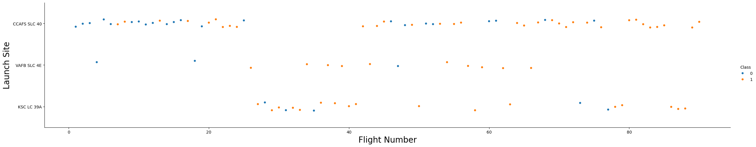
Flight Number vs. Launch Site
Class: 0 = Failure Class: 1 = Success

Slide 18
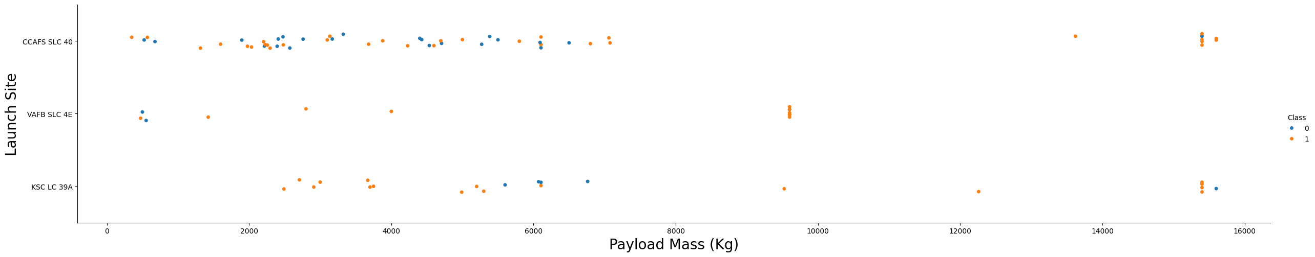
Payload vs. Launch Site
Class: 0 = Failure Class: 1 = Success

Slide 19
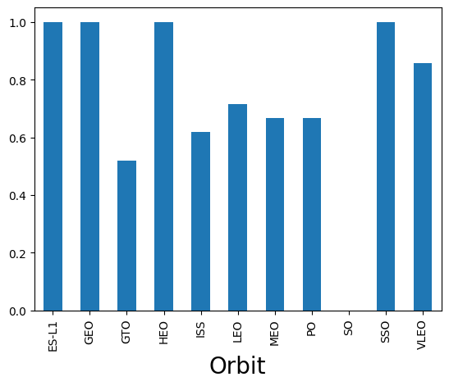
Success Rate vs. Orbit Type

Slide 20
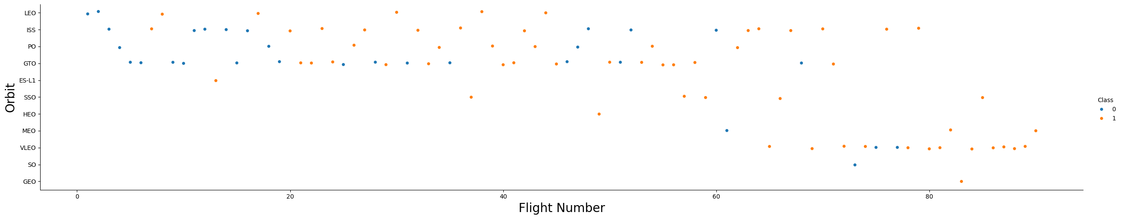
Flight Number vs. Orbit Type
Class: 0 = Failure Class: 1 = Success

Slide 21
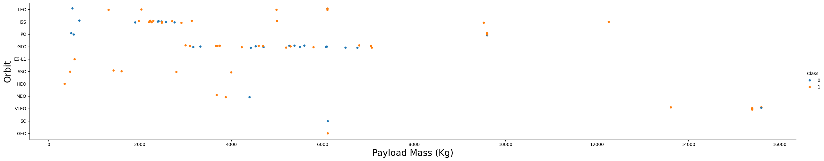
Payload vs. Orbit Type
Class: 0 = Failure Class: 1 = Success

Slide 22
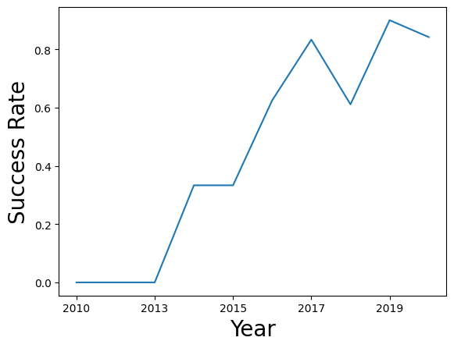
Launch Success Yearly Trend

Slide 23
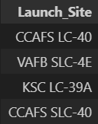
All Launch Site Names
Total of 4 launch sites

Slide 24
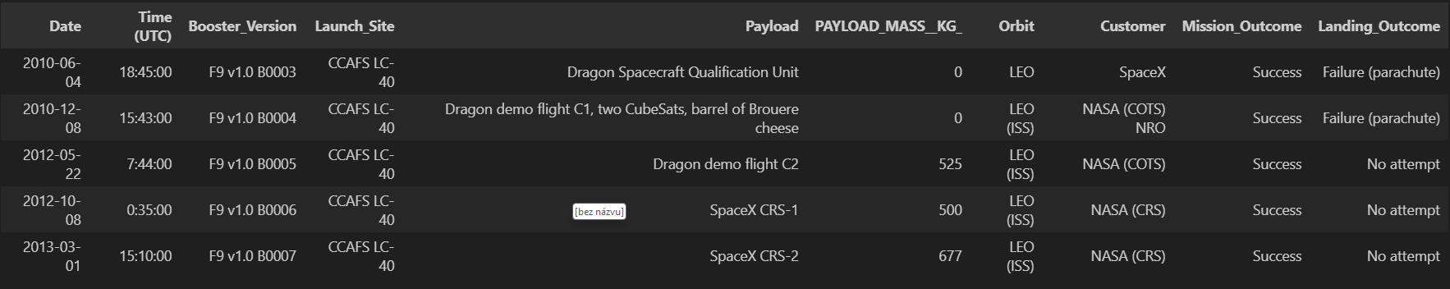
Launch Site Names Begin with 'CCA'

Slide 25
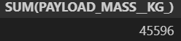
Total Payload Mass
Total payload mass is 45,596 Kg

Slide 26

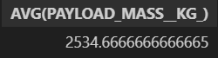
Average Payload Mass by F9 v1.1
Average payload mass by F9 v1.1 (all v1.1s) is 2,534.67 Kg

Slide 27
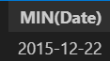
First Successful Ground Landing Date
The first successful landing date was on 22nd December in 2015

Slide 28
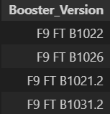
Successful Drone Ship Landing with Payload between 4000 and 6000
The following booster versions successfully landed with payloads between 4,000 and 6,000 Kg

Slide 29
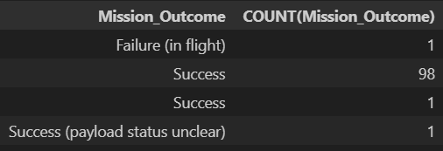
Total Number of Successful and Failure Mission Outcomes
There were total of 100 successful missions and 1 failure

Slide 30
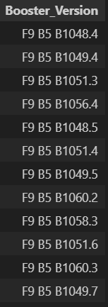
Boosters Carried Maximum Payload
These booster versions carried the maximum payload mass

Slide 31
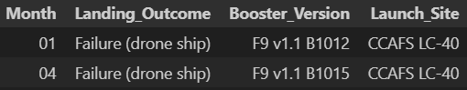
2015 Launch Records
In 2015 there were 2 failed landings on a drone ship. One in January and the other in April

Slide 32
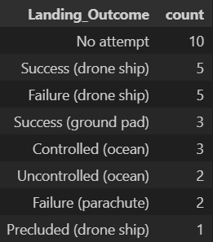
Rank Landing Outcomes Between 2010-06-04 and 2017-03-20
Landing outcomes ranked:
Most common was no attempt to land
Least common was Precluded on drone ship

Slide 33

Section 3

Slide 34
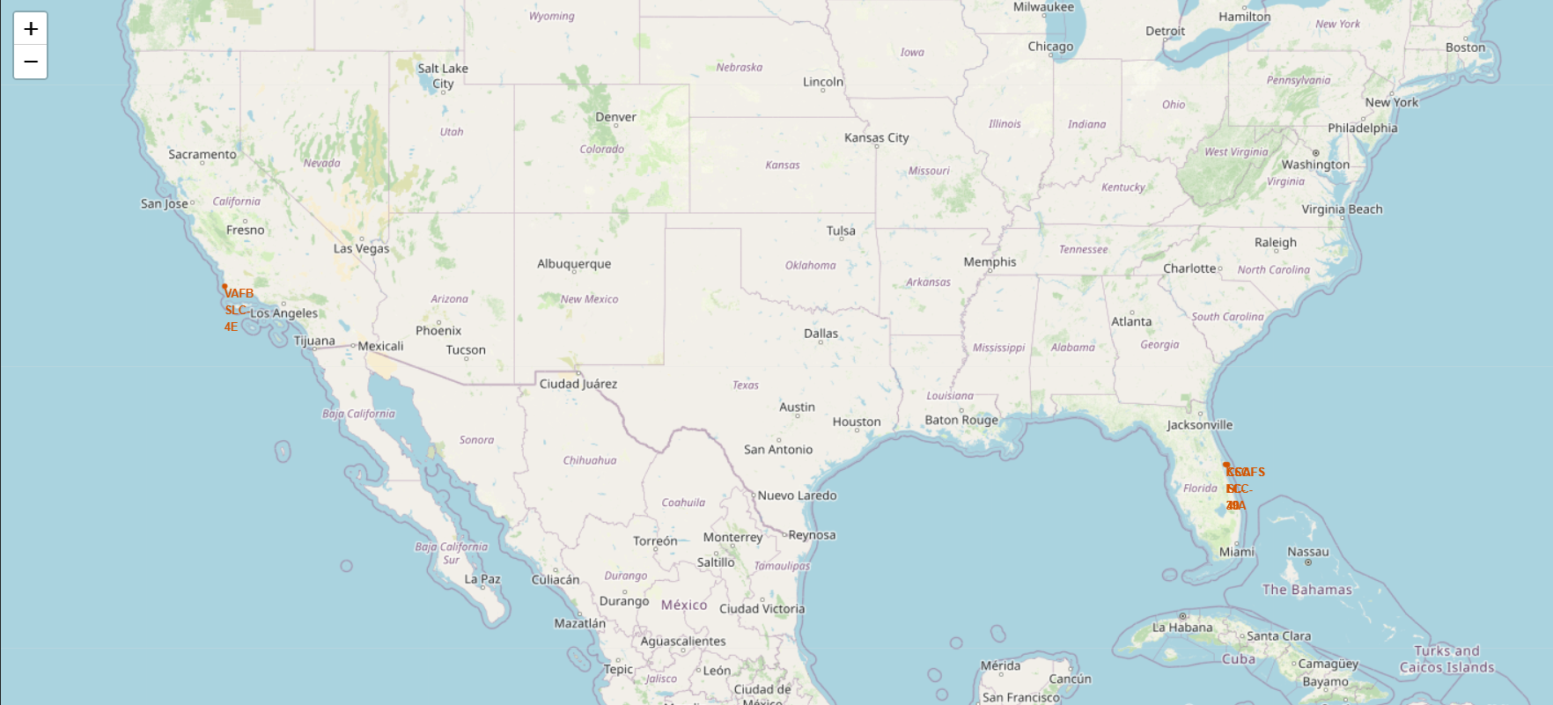
Map of Launch Sites in the US

Slide 35
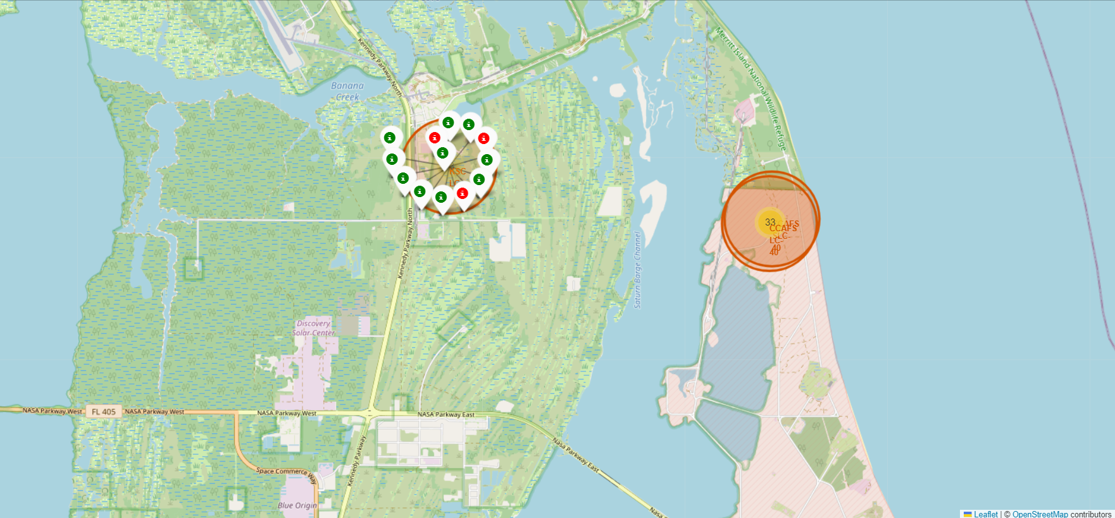
Launch Sites on the East Coast
Launch outcomes at KSC LC-39A site:

Slide 36
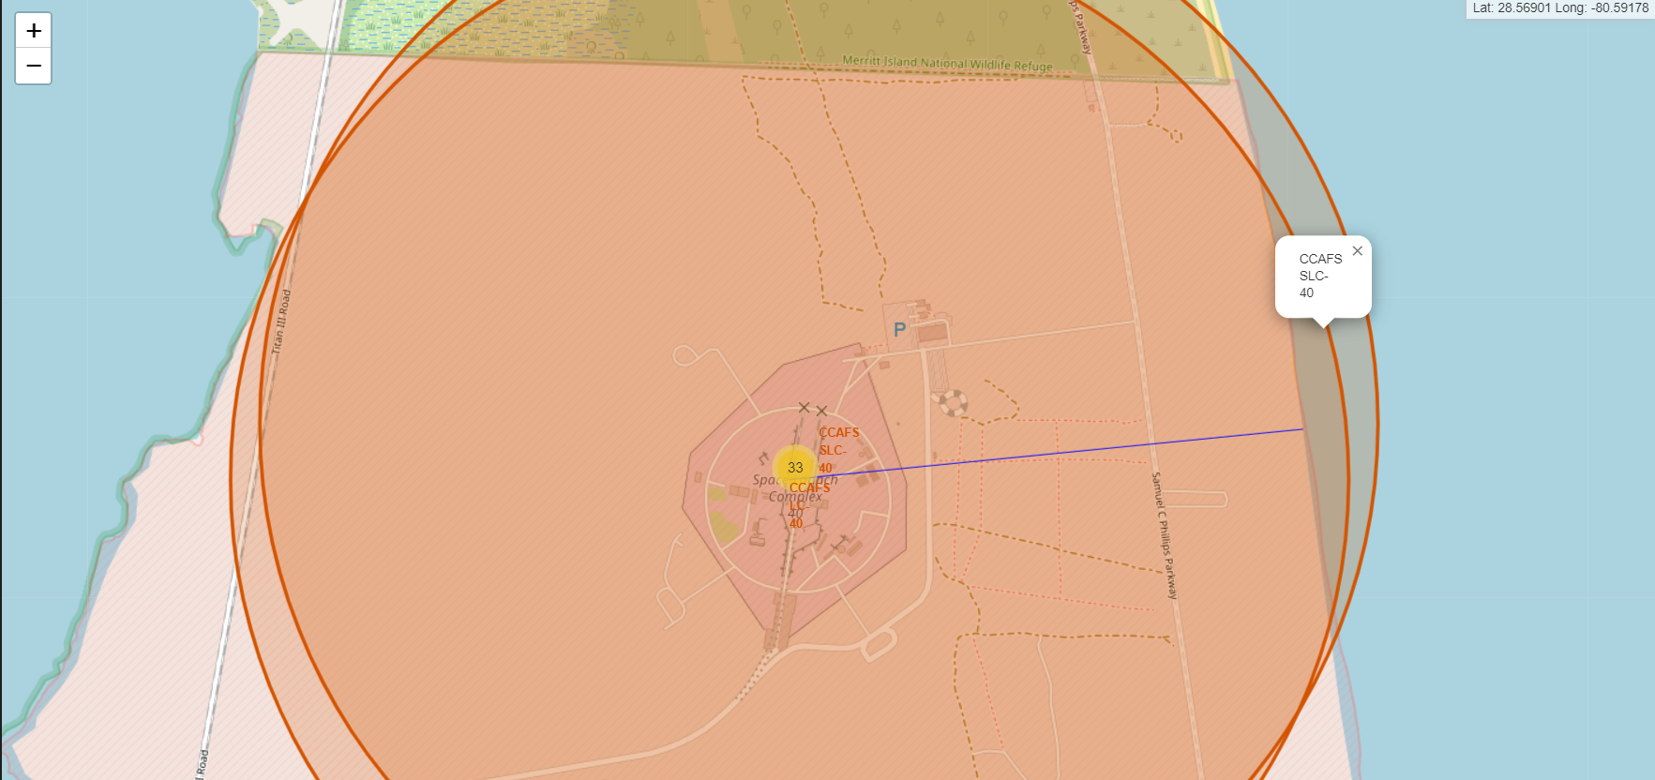
Nearest Coastline to Site CCAFS SLC-40

Slide 37

Section 4

Slide 38
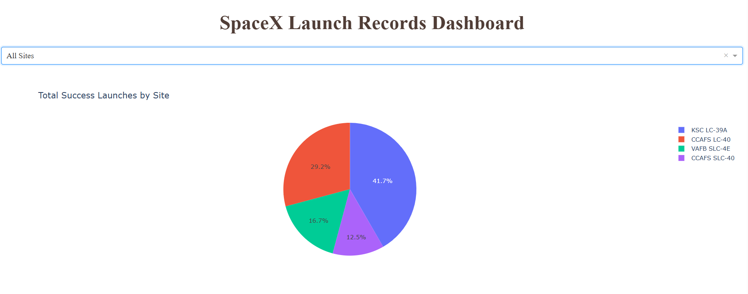
Successful Launches by Launch Site

Slide 39
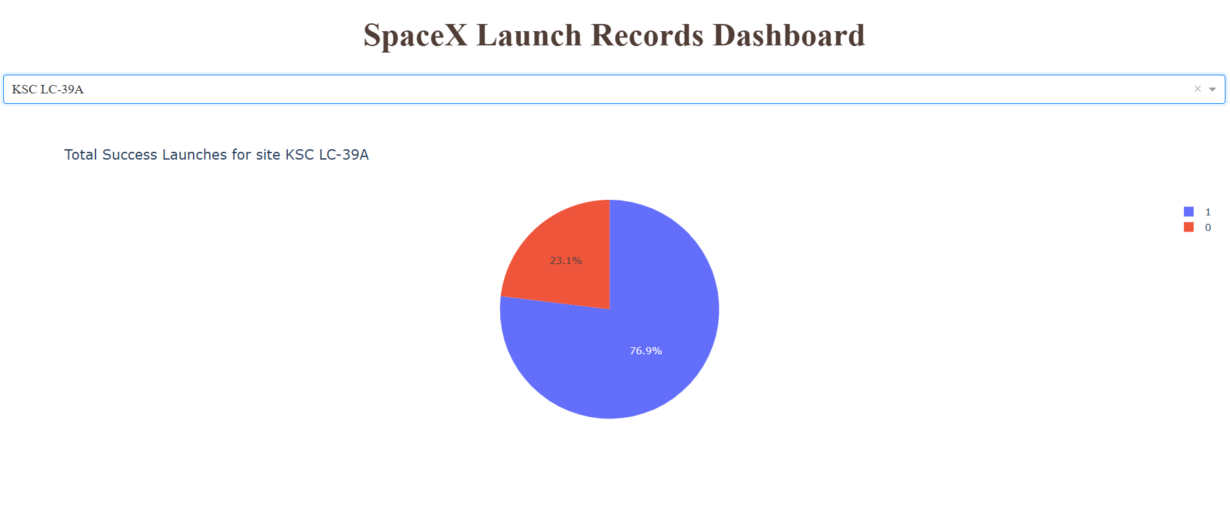
Succes rate of KSC LC-39A

Slide 40
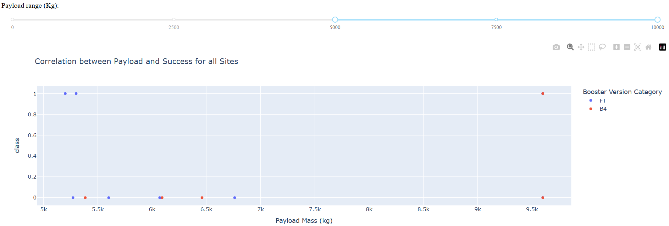
Correlation between Payload and Success
For payload higer than 5,000 Kg only two booster versions attempted landings
Only three landings were successful

Slide 41

Section 5

Slide 42
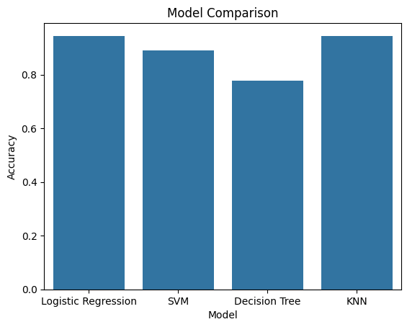
Classification Accuracy
Both KNN and Logistic Regression have the highest accuracy of 94 %

Slide 43
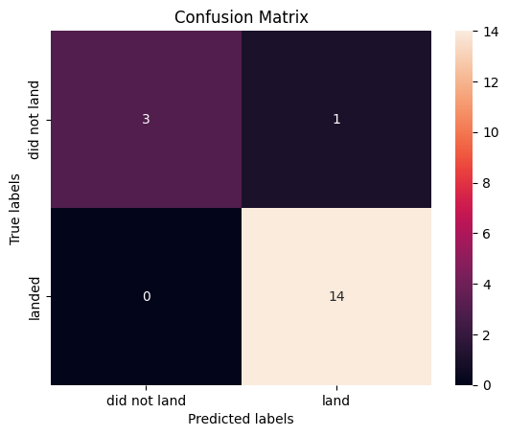
Confusion Matrix
Confusion matrices of KNN: and Logistic Regression:

Slide 44
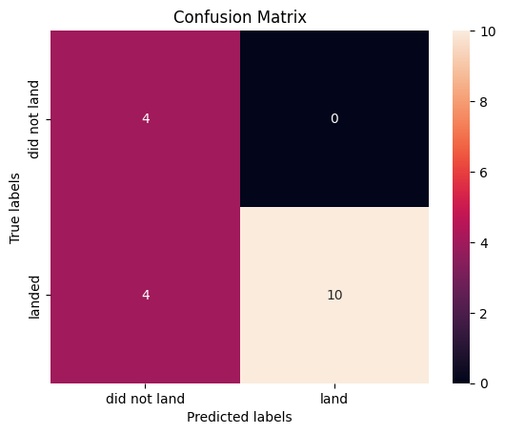
Conclusions
Logistic Regression and KNN are the best predictive models with 94 % accuracy
Decision Tree is the worst predictor with 78% accuracy
Decision Tree struggles to recognize some successful landings, but correctly recognizes all unsuccessful ones ->

Slide 45
Appendix
Include any relevant assets like Python code snippets, SQL queries, charts, Notebook outputs, or data sets that you may have created during this project

Slide 46


